Slide 1

PIERIAN CLOUD

Slide 2

Google Cloud Associate Cloud Engineer
GCP Basics
and IAM

Slide 3
Google Cloud Associate Cloud Engineer
As we begin to learn more about GCP services, we’ll need to understand access permissions for those services, for example, typically in an organization you don’t want every single person to have authority to create new cloud resources that cost money to run!

Slide 4
Google Cloud Associate Cloud Engineer
Section Overview:
Setting up and Accessing a GCP Account
GCP Resource Hierarchy
IAM Concepts:
Organization
Roles
Principals
Service Accounts

Slide 5
Google Cloud Associate Cloud Engineer
Many of the topics we discuss in this section will have direct documentation links.
Reading through these links are a great way to prepare for the certification exam!

Slide 6
Google Cloud Associate Cloud Engineer
Let’s get started!

Slide 7
Google Cloud Associate Cloud Engineer
Google Cloud
Account Setup

Slide 8
Google Cloud Associate Cloud Engineer
How can we access GCP?
https://app.pluralsight.com/course-player?clipId=12c7bbe0-e8ca-4267-b6e8-66b874f03a60

Slide 9
Google Cloud Associate Cloud Engineer
DEMO:
Setting up GCP Account

Slide 10
Google Cloud Associate Cloud Engineer
DEMO:
Cloud Marketplace

Slide 11
Google Cloud Associate Cloud Engineer
Identity and Access Management (IAM)

Slide 12
Google Cloud Associate Cloud Engineer
IAM (Identity and Access Management) is Google Cloud’s method of determining who can do what on a GCP resource.

Slide 13

Google Cloud Associate Cloud Engineer
IAM (Identity and Access Management) is Google Cloud’s method of determining who can do what on a GCP resource.
WHO

Slide 14

Google Cloud Associate Cloud Engineer
IAM (Identity and Access Management) is Google Cloud’s method of determining who can do what on a GCP resource.
WHO
PRIVILEGES ACTIONS

Slide 15
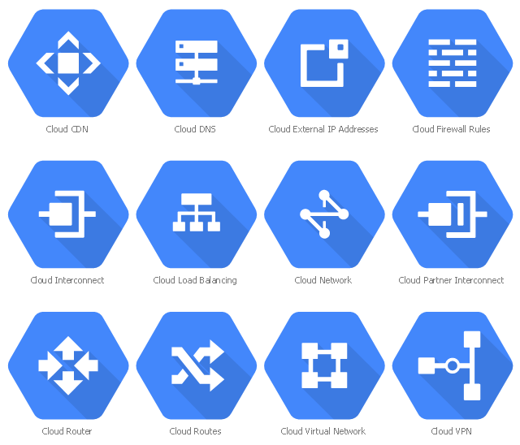
Google Cloud Associate Cloud Engineer
IAM (Identity and Access Management) is Google Cloud’s method of determining who can do what on a GCP resource.
WHO
PRIVILEGES ACTIONS
RESOURCES

Slide 16
Google Cloud Associate Cloud Engineer
Keep in mind that the “who” can actually be a person, group, or even an application.
There are two main concepts concerning IAM:
Organizing Resources and Hierarchy
Role Bindings and Role Assignment

Slide 17
Google Cloud Associate Cloud Engineer
We can think of roles as privileges that have a binding to a particular person (or group or application).
To really understand roles and policies (role bindings) effectively, we first need a high level overview of how we organize resources across an organization.

Slide 18
Google Cloud Associate Cloud Engineer
Let’s have a GCP organization and resource hierarchy discussion in the next lecture, and then we’ll have a deeper dive into roles!

Slide 19
Google Cloud Associate Cloud Engineer
GCP Organization
and Resource Hierarchy

Slide 20
Google Cloud Associate Cloud Engineer
When working with GCP, we want to make sure that only people with the correct permissions are allowed to own, edit, view, or adjust billing on GCP resources.
We can think of these different permissions of creation or management as policies.

Slide 21
Google Cloud Associate Cloud Engineer
In conjunction with the idea of IAM roles we need to account for an entire organization with its own policies.
We also need to think about how to organize our GCP resources in general.

Slide 22
Google Cloud Associate Cloud Engineer
GCP uses IAM (Identity and Access Management) to help define roles and policies across your organization’s Google Cloud services and resources.
We’ll be talking a lot more about IAM later on, this lecture is not very specific on IAM just quite yet!

Slide 23
Google Cloud Associate Cloud Engineer
The IAM primitive roles can be used to define a policy, essentially a set of permissions:
Owner
Editor
Viewer
Billing Administrator

Slide 24
Google Cloud Associate Cloud Engineer
You can think of an IAM policy as a set of roles and member bindings.
Essentially defining who is allowed to do what on GCP.
Example:
User Jose is allowed to only be a Viewer on a resource.

Slide 25
Google Cloud Associate Cloud Engineer
To fully understand IAM and policies, we first need to understand how GCP thinks about organizing both a cloud resource and the people using it.
We can visualize resource hierarchy and policy hierarchy as a graph…

Slide 26
Google Cloud Associate Cloud Engineer
ORG

Slide 27
Google Cloud Associate Cloud Engineer
Policy Inheritance
ORG

Slide 28
Google Cloud Associate Cloud Engineer
“ORG NODE” or ORGANIZATION
Organization top level, such as a company or domain (eg. www.company.com).
Policies can be defined at an organization level (and would continue down to lower levels).
ORG

Slide 29
Google Cloud Associate Cloud Engineer
ORG NODE
ORG

Slide 30
Google Cloud Associate Cloud Engineer
ORG NODE
A
FOLDERS
An optional “node” in your graph which can help with organization.
We can also define policies at this level.
ORG
B

Slide 31
Google Cloud Associate Cloud Engineer
ORG NODE
A
FOLDERS
You can also have sub-folders for further organizing.
ORG
C
B
D

Slide 32
Google Cloud Associate Cloud Engineer
ORG NODE
FOLDERS
ORG

Slide 33
Google Cloud Associate Cloud Engineer
ORG NODE
FOLDERS
ORG

Slide 34
Google Cloud Associate Cloud Engineer
ORG NODE
FOLDERS
PROJECTS
One of the key organizing tools we’ll use with GCP.
ORG

Slide 35
Google Cloud Associate Cloud Engineer
ORG NODE
FOLDERS
PROJECTS
Projects will hold inside the actual GCP resources being used.
Policy can be defined at a Project level.
ORG

Slide 36
Google Cloud Associate Cloud Engineer
ORG NODE
FOLDERS
PROJECTS
Track resource and quota usage.
Enable Budgets and Billing.
Create credentials and activate permissions.
Enable services, APIs, and Resources.
ORG

Slide 37
Google Cloud Associate Cloud Engineer
ORG NODE
FOLDERS
PROJECTS
We’ll learn a lot more about Projects specifics later on!
ORG

Slide 38
Google Cloud Associate Cloud Engineer
ORG NODE
FOLDERS
PROJECTS
ORG

Slide 39
Google Cloud Associate Cloud Engineer
ORG NODE
FOLDERS
PROJECTS
ORG

Slide 40
Google Cloud Associate Cloud Engineer
RESOURCES
These are the actual GCP services, like Compute, Storage, Big Data, and ML.
ORG NODE
FOLDERS
PROJECTS
ORG

Slide 41
Google Cloud Associate Cloud Engineer
RESOURCES
These are the actual GCP services, like Compute, Storage, Big Data, and ML.
ORG NODE
FOLDERS
PROJECTS
ORG
VM
SQL

Slide 42
Google Cloud Associate Cloud Engineer
RESOURCES
Only certain specific GCP resources will allow you to define policies at a resource level.
ORG NODE
FOLDERS
PROJECTS
ORG
VM
SQL

Slide 43
Google Cloud Associate Cloud Engineer
ORG NODE
FOLDERS
PROJECTS
RESOURCES
ORG

Slide 44
Google Cloud Associate Cloud Engineer
LEARNING ABOUT GCP:
Most of your time will be spent on a new project with a single resource.
ORG NODE
FOLDERS
PROJECTS
RESOURCES
ORG

Slide 45
Google Cloud Associate Cloud Engineer
ORG NODE
FOLDERS
PROJECTS
RESOURCES
ORG

Slide 46
Google Cloud Associate Cloud Engineer
ORG NODE
PROJECTS
RESOURCES
ORG

Slide 47
Google Cloud Associate Cloud Engineer
PROJECTS
RESOURCES
Very common learning and education setup!

Slide 48
Google Cloud Associate Cloud Engineer
ORG NODE
FOLDERS
PROJECTS
RESOURCES
ORG

Slide 49
Google Cloud Associate Cloud Engineer
You have flexibility to group your resources to your company structure with folders and projects.
You can also see billing information at a project level.
Let’s dive deeper into some of these levels of organization, starting with Projects.

Slide 50
Google Cloud Associate Cloud Engineer
Typically projects are going to be one of our main organizational tools inside of GCP.
Projects need:
Project ID
Project Name
Project Number

Slide 51
Google Cloud Associate Cloud Engineer
Projects
 | Unique? | Assigned? | Mutability?
Project ID
Project Name
Project Number

Slide 52
Google Cloud Associate Cloud Engineer
Projects
 | Unique? | Assigned? | Mutability?
Project ID | Globally Unique | You Choose | Immutable
Project Name
Project Number

Slide 53
Google Cloud Associate Cloud Engineer
Projects
 | Unique? | Assigned? | Mutability?
Project ID | Globally Unique | You Choose | Immutable
Project Name | No Unique Constraint | You Choose | Mutable
Project Number

Slide 54
Google Cloud Associate Cloud Engineer
Projects
 | Unique? | Assigned? | Mutability?
Project ID | Globally Unique | You Choose | Immutable
Project Name | No Unique Constraint | You Choose | Mutable
Project Number | Globally Unique | GCP Assigned | Immutable

Slide 55
Google Cloud Associate Cloud Engineer
Projects
 | Unique? | Assigned? | Mutability?
Project ID | Globally Unique | You Choose | Immutable
Project Name | No Unique Constraint | You Choose | Mutable
Project Number | Globally Unique | GCP Assigned | Immutable

Slide 56
Google Cloud Associate Cloud Engineer
Projects
 | Unique? | Assigned? | Mutability?
Project ID | Globally Unique | You Choose | Immutable
Project Name | No Unique Constraint | You Choose | Mutable
Project Number | Globally Unique | GCP Assigned | Immutable

Slide 57
Google Cloud Associate Cloud Engineer
Project ID:
Typically human readable strings that can be used for reference.
Example: company-vision-product
Project Name:
Used for your convenience:
Example: current-vision-api-testing

Slide 58
Google Cloud Associate Cloud Engineer
Project ID:
Typically human readable strings that can be used for reference.
Example: company-vision-product
Project Name:
Used for your convenience:
Example: company-vision-platform

Slide 59
Google Cloud Associate Cloud Engineer
Now let’s discuss Folders and how they work with policies…

Slide 60
Google Cloud Associate Cloud Engineer
Folders are for your convenience and you should take advantage of them to match GCP to your own organization.
Let’s see a visual example of this…

Slide 61
Google Cloud Associate Cloud Engineer
ORG
Folders can be assigned with policies to reflect an organization’s Departments, with subfolders reflecting teams within a department.
Dept. X
Dept. Y
Team
A
Team
B

Slide 62
Google Cloud Associate Cloud Engineer
ORG
Folders don’t require subfolders (and folders themselves are not required).
You can have Projects directly underneath a folder.
Dept. X
Dept. Y
Team
A
Team
B
Project

Slide 63
Google Cloud Associate Cloud Engineer
ORG
Folders are a very useful tool to assign policies and permissions at a team or department level.
Dept. X
Dept. Y
Team
A
Team
B
Project

Slide 64
Google Cloud Associate Cloud Engineer
ORG
Projects within a Folder will automatically inherit the IAM policies.
Dept. X
Dept. Y
Project
X1
Project
X2
Project
Y1

Slide 65
Google Cloud Associate Cloud Engineer
ORG
Projects within a Folder will automatically inherit the IAM policies.
Dept. X
Dept. Y
Project
X1
Project
X2
Project
Y1

Slide 66
Google Cloud Associate Cloud Engineer
ORG
Projects within a Folder will automatically inherit the IAM policies.
Dept. X
Dept. Y
Project
X1
Project
X2
Project
Y1

Slide 67
Google Cloud Associate Cloud Engineer
ORG
You could have set those policies at a Project level, but that’s a lot of duplicate work!
Dept. X
Dept. Y
Project
X1
Project
X2
Project
Y1

Slide 68
Google Cloud Associate Cloud Engineer
Now let’s discuss the Organization node at the very top and it’s general use cases.

Slide 69
Google Cloud Associate Cloud Engineer
As you may imagine the Organization has some special properties:
Organization Policy Administrator
Broad control over all cloud resources being used in the projects underneath it.
ORG

Slide 70
Google Cloud Associate Cloud Engineer
As you may imagine the Organization has some special properties:
Organization Policy Administrator
Can create Project Creator roles, which allows for the creation of Projects and Resources (aka spend $!)
ORG

Slide 71
Google Cloud Associate Cloud Engineer
How are Organization Nodes created?

Slide 72
Google Cloud Associate Cloud Engineer
How are Organization Nodes created?
Case One: GSuite Customer
Your company already runs on a GSuite domain with your internal email running on Gmail, using Google Docs, etc…

Slide 73
Google Cloud Associate Cloud Engineer
How are Organization Nodes created?
Case Two: Create an organization node with Google Cloud Identity
cloud.google.com/identity

Slide 74
Google Cloud Associate Cloud Engineer
Finally let’s have a quick discussion on policies set at a lower level that possibly counteract a higher level policy.

Slide 75
Google Cloud Associate Cloud Engineer
Recall that resources inherit policies from parent:
Resource policies are a union of parent and resource.
GCP refers to this as the effective policy at that resource.

Slide 76
Google Cloud Associate Cloud Engineer
Let’s imagine a talented senior executive at the top ranks of a company wants to be able to see projects throughout the company, but we also want to make sure she doesn’t accidentally create or edit existing projects.
She can only get or list projects not create or edit them!

Slide 77
Google Cloud Associate Cloud Engineer
ORG NODE
FOLDERS
PROJECTS
RESOURCES
ORG

Slide 78
Google Cloud Associate Cloud Engineer
ORG NODE
FOLDERS
PROJECTS
RESOURCES
Policy:
“Raha as a Viewer role (get and list permissions)”
ORG

Slide 79
Google Cloud Associate Cloud Engineer
ORG NODE
FOLDERS
PROJECTS
RESOURCES
Policy:
“Raha as a Viewer role (get and list permissions)”
ORG

Slide 80
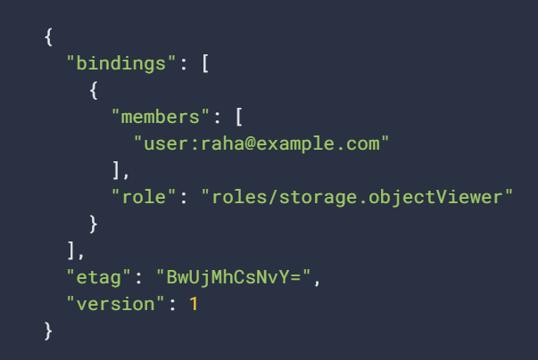
Google Cloud Associate Cloud Engineer
The way this actually works inside GCP is through a role binding:

Slide 81
Google Cloud Associate Cloud Engineer
You’ll understand this more as we dive deeper into IAM inside of GCP!

Slide 82
Google Cloud Associate Cloud Engineer
Our company is now trying to launch a new product and we need Raha’s help on a specific GCP project, we now want her to be able to actually create resources underneath a project!
How does this work inside GCP?

Slide 83
Google Cloud Associate Cloud Engineer
ORG NODE
FOLDERS
PROJECTS
RESOURCES
Policy:
“Raha as a Viewer role (get and list permissions)”
ORG

Slide 84
Google Cloud Associate Cloud Engineer
ORG NODE
FOLDERS
PROJECTS
RESOURCES
Policy:
“Raha as a Creator role (create permissions)”
Policy:
“Raha as a Viewer role (get and list permissions)”
ORG

Slide 85
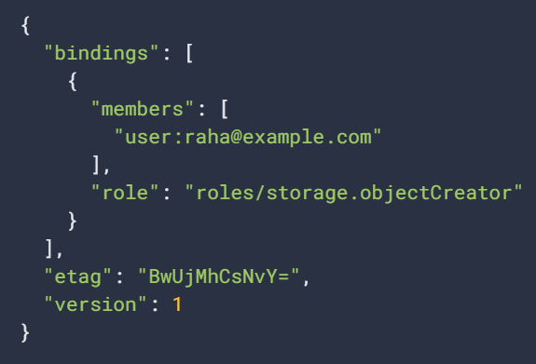
Google Cloud Associate Cloud Engineer
Raha’s role binding at the project node:

Slide 86
Google Cloud Associate Cloud Engineer
Now here’s the critical question:
Does Raha actually get Creator permission at this Project level or because of policy inheritance is she only able to view since she only had viewer role bindings at an org node level?

Slide 87
Google Cloud Associate Cloud Engineer
A beginner mistake is to think of policies as “overriding” each other.
Instead, GCP users should think of policies at a node as the union of the role binding policies that exist at the node.
A union is a combination of both sets of role bindings.

Slide 88
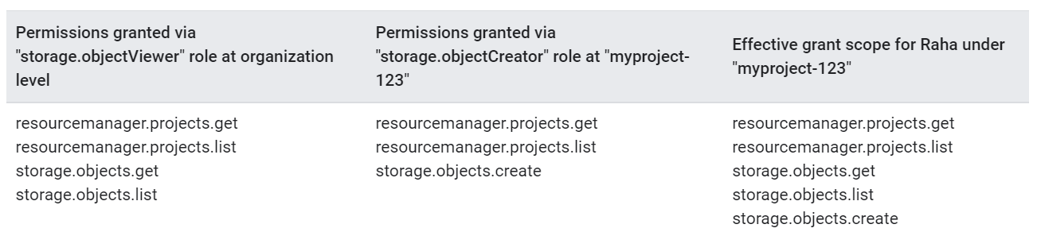
Google Cloud Associate Cloud Engineer
Raha’s role binding policies:
ORG
ORG

Slide 89
Google Cloud Associate Cloud Engineer
Recommending Reading:
Resource Hierarchy Docs:
cloud.google.com/iam/docs/ overview#resource-hierarchy
Policy Docs:
cloud.google.com/iam/docs/policies

Slide 90
Google Cloud Associate Cloud Engineer
We recommend you visit those links once we cover more details about IAM, like roles and bindings.

Slide 91
Google Cloud Associate Cloud Engineer
Review:
We learned the Google Cloud Resource Hierarchy.
Policies are inherited from parent nodes.
Less restrictive policies will be able to have a union with more restrictive parent policy, allowing the less restrictive policy.

Slide 92
Google Cloud Associate Cloud Engineer
Up next:
Let’s get a better understanding of IAM roles and how they offer levels of access on GCP!

Slide 93
Google Cloud Associate Cloud Engineer
DEMO:
Resource Hierarchy

Slide 94
Google Cloud Associate Cloud Engineer
Demo:
Let’s get some practice with creating resource hierarchy:
https://www.youtube.com/watch?v=jJOZUQTwdLk

Slide 95
Google Cloud Associate Cloud Engineer
Outcome:
We will create a project with a simple compute engine.

Slide 96
Google Cloud Associate Cloud Engineer
IAM:
Organization

Slide 97
Google Cloud Associate Cloud Engineer
We know that the organization node is the top level (root node) for your Google Cloud resources.
As we’ve mentioned, there are some very special roles, capabilities and factors that are specific to the organization node.
Let’s discuss them in more detail now…

Slide 98
Google Cloud Associate Cloud Engineer
There are two main roles that match with the idea of an Organization level:
Workspace (pka G Suite) or Cloud Identity Super Administrator
Organization Admin
Let’s discuss these roles and their use cases.

Slide 99
Google Cloud Associate Cloud Engineer
When your organization signs up for Google Cloud, they’ve either already been a Google Workspace (pka G Suite) customer or they created a Cloud Identity account.
The Workspace or Cloud Identity will create a super administrator, which is one of the most high level roles possible on GCP (and is associated with non-GCP services).

Slide 100
Google Cloud Associate Cloud Engineer
Super Administrator:
Assign Organization Admin roles.
Main point of contact for recovery.
General control of Workspace or Cloud Identity account and Organization resource on GCP.

Slide 101
Google Cloud Associate Cloud Engineer
Organization Admin:
Defines IAM policies and role bindings.
Can create structure of GCP resource hierarchy.
Creates roles across organization for general GCP use (e.g. makes Raha a Project Viewer).
ORG

Slide 102
Google Cloud Associate Cloud Engineer
Organization Viewer Role:
Allows view access to all resources on GCP account.
Typical for a high level executive who should be allowed to view all folders and projects, but probably shouldn’t be allowed to create or edit projects.

Slide 103
Google Cloud Associate Cloud Engineer
If we go further down the hierarchy to folders and projects, there are a few resource management roles there as well…

Slide 104
Google Cloud Associate Cloud Engineer
ORG NODE
FOLDERS
PROJECTS
ORG

Slide 105
Google Cloud Associate Cloud Engineer
ORG NODE
Admin:
Full Control over all resources
Viewer:
Viewing access for all resources
FOLDERS
Admin:
Full Control over folders
Creator:
Browse folder hierarchy and create folders
Viewer:
Viewing folder or folders and projects below it
PROJECTS
Creator:
Create new projects (this makes the user the owner of the newly created project)
Deleter:
Grants deletion privileges over projects

Slide 106
Google Cloud Associate Cloud Engineer
We’ve thrown out a lot of terminology surrounding roles, such as owner, viewer, editor, etc…
Before we continue further into IAM, we should have a deeper discussion into roles in the next lecture and explore the details behind what access they can give.

Slide 107
Google Cloud Associate Cloud Engineer
Review:
We discussed specific roles that are special to the organization root node, such as the Organization Admin role.
We also briefly explored roles at other levels, such as folders and projects.

Slide 108
Google Cloud Associate Cloud Engineer
Up Next:
Let’s have a more comprehensive overview of IAM roles, including basic roles, predefined roles, and even custom roles!

Slide 109
Google Cloud Associate Cloud Engineer
Roles

Slide 110
Google Cloud Associate Cloud Engineer
Recall that IAM’s purpose is to define who can do what on a GCP resource.
WHO
PERMISSIONS
RESOURCES

Slide 111
Google Cloud Associate Cloud Engineer
A role is a collection of permissions on resources.
WHO
PERMISSIONS
RESOURCES

Slide 112
Google Cloud Associate Cloud Engineer
A role is simply a set of permissions.
GCP defines these permissions as subsets on a string.
Let’s take a look at some example permissions to understand!

Slide 113
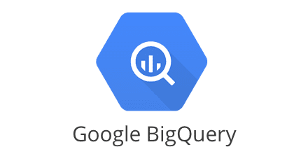
Google Cloud Associate Cloud Engineer
Imagine a new data analyst at the organization will use Google’s BigQuery tool to create reports.

Slide 114
Google Cloud Associate Cloud Engineer
BigQuery has many levels of features, some of which may be more important than others for the organization.

Slide 115
Google Cloud Associate Cloud Engineer
For example BigQuery has tables of data.
Should the analyst have permission to delete tables? Or only to create them?

Slide 116
Google Cloud Associate Cloud Engineer
Example Permission Strings:
bigquery.tables.create
bigquery.tables.delete

Slide 117
Google Cloud Associate Cloud Engineer
There are hundreds of example of similar permission strings for all of GCP’s services and resource hierarchy.
A role is simply a list of these permissions (aka privileges) assigned to a person (or principal or service account).

Slide 118
Google Cloud Associate Cloud Engineer
There are three types of roles in IAM:
Basic Roles
Predefined Roles
Custom Roles
Let’s go through each of these types, starting with basic roles!

Slide 119
Google Cloud Associate Cloud Engineer
Basic Roles
Owner
Editor
Viewer
Don’t let the name “basic” deceive you, basic roles are actually extremely powerful!

Slide 120
Google Cloud Associate Cloud Engineer
Basic roles include thousands of permissions across all Google Cloud services.
In production environments, do not grant basic roles unless there is no alternative.
Instead, grant the most limited predefined roles or custom roles that meet your needs.

Slide 121
Google Cloud Associate Cloud Engineer
ORG NODE
FOLDERS
PROJECTS
ORG

Slide 122



Google Cloud Associate Cloud Engineer
ORG NODE
FOLDERS
PROJECTS
ORG

Slide 123
Google Cloud Associate Cloud Engineer
OWNER
EDITOR
VIEWER
Read only access

Slide 124
Google Cloud Associate Cloud Engineer
OWNER
EDITOR
VIEWER
Deploy Apps
Modify Code
Configure Resources
Plus
Read only access

Slide 125
Google Cloud Associate Cloud Engineer
OWNER
EDITOR
VIEWER
Deploy Apps
Modify Code
Configure Resources
Plus
Read only access

Slide 126
Google Cloud Associate Cloud Engineer
OWNER
EDITOR
VIEWER
Invite or Remove Principals
Delete Projects
Plus
Deploy Apps
Modify Code
Configure Resources
Plus
Read only access

Slide 127
Google Cloud Associate Cloud Engineer
OWNER
EDITOR
VIEWER
Invite or Remove Principals
Delete Projects
Plus
Deploy Apps
Modify Code
Configure Resources
Plus
Read only access

Slide 128
Google Cloud Associate Cloud Engineer
OWNER
EDITOR
VIEWER
Invite or Remove Principals
Delete Projects
Plus
Deploy Apps
Modify Code
Configure Resources
Plus
Read only access

Slide 129
Google Cloud Associate Cloud Engineer
As mentioned, these Basic roles are very “coarse grained” , meaning they give lots of permissions over potentially large areas of a GCP account.
Fortunately, GCP provides predefined roles that apply to particular GCP services in a project (or folder or organization).

Slide 130
Google Cloud Associate Cloud Engineer
Predefined Roles
These roles are created and maintained by Google.
Google automatically updates their permissions as necessary, such as when Google Cloud adds new features or services.

Slide 131
Google Cloud Associate Cloud Engineer
Predefined Roles
There are a lot of predefined roles already created for you by GCP.
Full List:
cloud.google.com/iam/docs/ understanding-roles#predefined

Slide 132
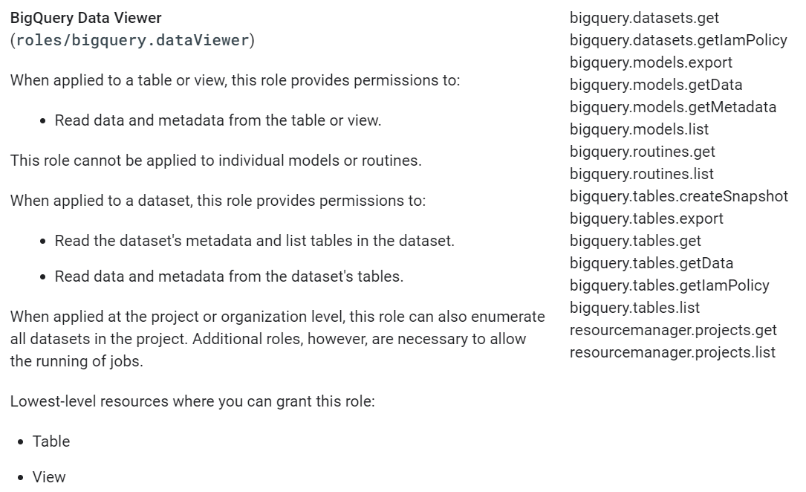
Google Cloud Associate Cloud Engineer
Predefined Roles

Slide 133
Google Cloud Associate Cloud Engineer
Predefined Roles
Predefined roles are much easier to work with and are a great starting point when managing people in an organization using GCP.

Slide 134
Google Cloud Associate Cloud Engineer
Predefined Roles
How to choose a predefined role:
Identify the necessary permissions.
Find roles that contain the permissions.
Choose the most appropriate roles.
Decide where to grant the roles.
Grant the roles to a principal.

Slide 135
Google Cloud Associate Cloud Engineer
There will be instances where the basic roles give too many permissions and a predefined role is not an exact match for what you are looking for.
In this case, we can create custom roles for our GCP users.

Slide 136
Google Cloud Associate Cloud Engineer
Custom Roles:
Create new title and description
Define the role launch state (e.g. alpha, beta, etc…)
Add permissions
E.g. add compute.instances.get

Slide 137
Google Cloud Associate Cloud Engineer
Review:
Roles are simply sets of permissions.
There are 3 main role types:
Basic Roles
Predefined Roles
Custom Roles

Slide 138
Google Cloud Associate Cloud Engineer
Up Next:
Let’s get some hands-on practice with creating a new role in GCP!

Slide 139
Google Cloud Associate Cloud Engineer
DEMO:
Creating a Role

Slide 140
Google Cloud Associate Cloud Engineer
TO DO:
Create a custom role

Slide 141
Google Cloud Associate Cloud Engineer
Principals

Slide 142
Google Cloud Associate Cloud Engineer
Recall that IAM’s purpose is to define who can do what on a GCP resource.
WHO
PERMISSIONS
RESOURCES

Slide 143
Google Cloud Associate Cloud Engineer
A principal helps define the “who” part of this process.
WHO
PERMISSIONS
RESOURCES

Slide 144
Google Cloud Associate Cloud Engineer
Note!
In the past, GCP referred to principals as “members”.
There are a few API calls where the documentation still uses the term “members”, just be aware that this is the same as a principal!

Slide 145
Google Cloud Associate Cloud Engineer
A principal can be a Google Account (for end users), a service account (for applications and compute workloads), a Google group, or a Google Workspace account or Cloud Identity domain that can access a resource.

Slide 146
Google Cloud Associate Cloud Engineer
The identity of a principal is an email address associated with a user, service account, or Google group; or a domain name associated with a Google Workspace account or a Cloud Identity domain.

Slide 147
Google Cloud Associate Cloud Engineer
Principals can be of the following types:
Google Account
Service Account
Google Group
Google Workspace Account
Cloud Identity Domain
All Authenticated Users
All Users

Slide 148
Google Cloud Associate Cloud Engineer
Google Account
A Google Account represents a developer, an administrator, or any other person who interacts with Google Cloud.

Slide 149
Google Cloud Associate Cloud Engineer
Service Account
A service account is an account for an application or compute workload instead of an individual end user.

Slide 150
Google Cloud Associate Cloud Engineer
Google Group
A Google group is a named collection of Google Accounts and service accounts.

Slide 151
Google Cloud Associate Cloud Engineer
Google Workspace Account
A Google Workspace account represents a virtual group of all of the Google Accounts that it contains.
Google Workspace accounts are associated with your organization's internet domain name, such as example.com.

Slide 152
Google Cloud Associate Cloud Engineer
Cloud Identity Domain
A Cloud Identity domain is like a Google Workspace account, because it represents a virtual group of all Google Accounts in an organization.
However, Cloud Identity domain users don't have access to Google Workspace applications and features.

Slide 153
Google Cloud Associate Cloud Engineer
All Authenticated Users
The value allAuthenticatedUsers is a special identifier that represents all service accounts and all users on the internet who have authenticated with a Google Account.

Slide 154
Google Cloud Associate Cloud Engineer
All Users
The value allUsers is a special identifier that represents anyone who is on the internet, including authenticated and unauthenticated users.

Slide 155
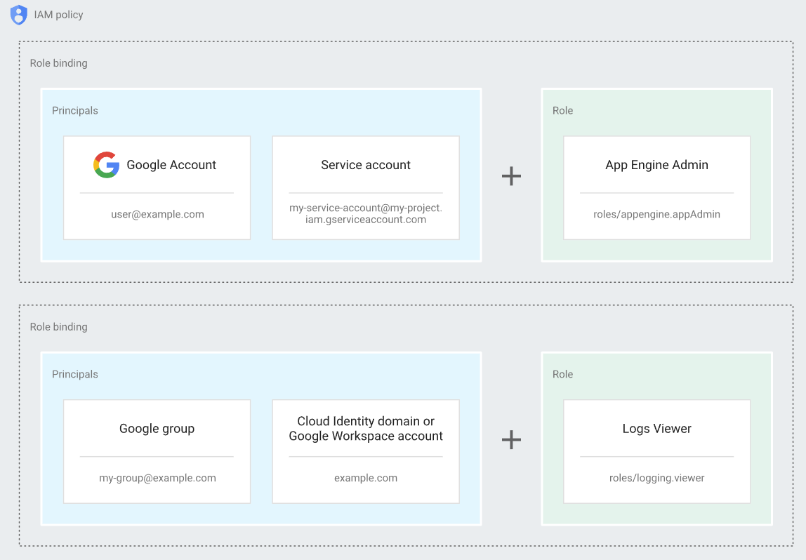
Google Cloud Associate Cloud Engineer
A full IAM Policy then becomes a set of role bindings from a principal to a resource.

Slide 156
Google Cloud Associate Cloud Engineer
A full IAM Policy then becomes a set of role bindings from a principal to a resource.

Slide 157
Google Cloud Associate Cloud Engineer
Review:
Principals (pka Members) are the “who” of IAM Policy.
We create IAM Policy by binding a principal to a role (where a role is simply a set of permissions).

Slide 158
Google Cloud Associate Cloud Engineer
Up Next:
We’ll learn about service accounts, which is when interactions need to occur on a server to server basis.

Slide 159
Google Cloud Associate Cloud Engineer
Service Accounts

Slide 160
Google Cloud Associate Cloud Engineer
As cloud computing becomes more automated, you’ll often have scripts, APIs, or other applications interacting with Google Cloud.
These types of account interactions are known as service accounts.

Slide 161
Google Cloud Associate Cloud Engineer
For example, a service account can be attached to a Compute Engine VM, so that applications running on that VM can authenticate as the service account.

Slide 162
Google Cloud Associate Cloud Engineer
The service account can be granted IAM roles that let it access resources. The service account is used as the identity of the application, and the service account's roles control which resources the application can access.
A service account is identified by its email address, which is unique to the account.

Slide 163
Google Cloud Associate Cloud Engineer
Service accounts differ from user accounts in a few key ways:
Service accounts do not have passwords, and cannot log in via browsers or cookies.

Slide 164
Google Cloud Associate Cloud Engineer
Service accounts differ from user accounts in a few key ways:
Service accounts are associated with public/private RSA key pairs that are used for authentication to Google, and for signing data.

Slide 165
Google Cloud Associate Cloud Engineer
Service accounts differ from user accounts in a few key ways:
You can let other users or service accounts impersonate a service account.

Slide 166
Google Cloud Associate Cloud Engineer
Service accounts differ from user accounts in a few key ways:
Service accounts do not belong to your Google Workspace domain, unlike user accounts.
If you share Google Workspace assets, like docs or events, with your entire Google Workspace domain, they are not shared with service accounts.

Slide 167
Google Cloud Associate Cloud Engineer
There are three types of service accounts:
User-managed service accounts
Default service accounts
Google-managed service accounts

Slide 168
Google Cloud Associate Cloud Engineer
User-managed service accounts
You can create user-managed service accounts in your project using the IAM API, the Cloud Console, or the gcloud command-line tool.
You are responsible for managing and securing these accounts.
By default, you can create up to 100 user-managed service accounts in a project.

Slide 169
Google Cloud Associate Cloud Engineer
Default service accounts
When you enable or use some Google Cloud services, they create user-managed service accounts that enable the service to deploy jobs that access other Google Cloud resources.

Slide 170
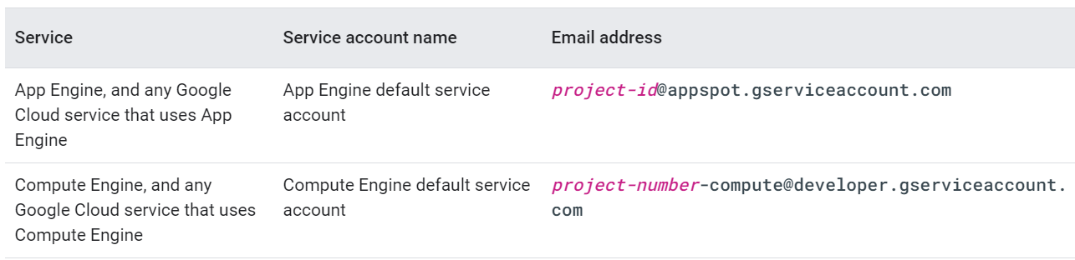
Google Cloud Associate Cloud Engineer
Default service accounts

Slide 171
Google Cloud Associate Cloud Engineer
Google-managed service accounts
Some Google Cloud services need access to your resources so that they can act on your behalf.
To meet this need, Google creates and manages service accounts for many Google Cloud services.

Slide 172
Google Cloud Associate Cloud Engineer
Google-managed service accounts
You might see Google-managed service accounts in your project's IAM policy, in audit logs, or on the IAM page in the Cloud Console.
Google-managed service accounts are not listed in the Service accounts page in the Cloud Console.

Slide 173
Google Cloud Associate Cloud Engineer
Google-managed service accounts
Google APIs Service Agent.
Your project is likely to contain a service account named the Google APIs Service Agent, with an email address that uses the following format: project-number@cloudservices.gserviceaccount.com

Slide 174
Google Cloud Associate Cloud Engineer
Google-managed service accounts
Role manager for Google-managed service accounts.
Your audit logs for IAM might refer to the service account: service-agent-manager@system.gserviceaccount.com.

Slide 175
Google Cloud Associate Cloud Engineer
Service Accounts
Both User-Managed and Google-Managed service accounts use a security format known as public/private key encryption to keep your resources secure.

Slide 176
Google Cloud Associate Cloud Engineer
Service Accounts
This RSA encryption technique requires that the private key be held securely.
Depending on the type of service account being used, the availability of these keys is different.

Slide 177
Google Cloud Associate Cloud Engineer
Google-Managed Service Accounts | User-Managed Service Accounts
All service accounts have Google-managed keys. Google stores both the private and public version of the key. Each public key can be used for signing for only 2 weeks. Private keys are never directly accessible. | Google only stores the public part of the user-managed key. Users are responsible for private key security. Can be administered through the IAM API, Console, of gcloud. Can have up to 10 service account keys.

Slide 178
Google Cloud Associate Cloud Engineer
Review:
We learned about the different types of service accounts and how they differ from a typical user account.

Slide 179
Google Cloud Associate Cloud Engineer
Up Next:
A final review of best practices for IAM.

Slide 180
Google Cloud Associate Cloud Engineer
IAM
Review and Best Practices

Slide 181
Google Cloud Associate Cloud Engineer
Let’s have a quick review of IAM and go through some recommendations from Google Cloud on best practices!

Slide 182
Google Cloud Associate Cloud Engineer
Resource Hierarchy:
Use projects to group resources with expected similar IAM permissions.
Always keep in mind policy inheritance throughout your organization.

Slide 183
Google Cloud Associate Cloud Engineer
Resource Hierarchy:
Recall the principle of least privilege which states that a resource should only have access to the exact resource(s) it needs in order to function.
For example, if a service is performing an automated database backup, the service should be restricted to read-only permissions on exactly one database.

Slide 184
Google Cloud Associate Cloud Engineer
Roles:
Remember that the basic “primitive” roles such as “viewer” or “editor” are actually very powerful and should seldom be used unless meant for people who need full access across your GCP organization.

Slide 185
Google Cloud Associate Cloud Engineer
Roles:
Utilize Google Groups within clouds to easily assign roles to groups of people to easily update or edit roles to multiple people.
More information on this:
cloud.google.com/iam/docs/ groups-in-cloud-console

Slide 186
Google Cloud Associate Cloud Engineer
Service Accounts:
Always be careful when granting a serviceAccountUser role as it provides access to all the resources that the Service Account has access to.
Use clearly defined display names to easily identify the use case and purpose of the Service Account.

Slide 187
Google Cloud Associate Cloud Engineer
Service Accounts:
Depending on the type of Service Account used, you should establish organization best practices for working with and storing keys.
Rotating and renewing keys on a regular schedule is common best practice.

Slide 188
Google Cloud Associate Cloud Engineer
Identity Aware Proxy (IAP):
Depending on your use cases, you may have GCP web applications that need to have different levels of access depending on the user of the web app.
IAP is a service from Google Cloud that helps automate this for GCP web apps.

Slide 189
Google Cloud Associate Cloud Engineer
Identity Aware Proxy (IAP):
Consider a web application that has:
General Public Facing Page
Support Ticket Page
Authorized User Application Page

Slide 190
Google Cloud Associate Cloud Engineer
Identity Aware Proxy (IAP):
Consider a web application that has:
General Public Facing Page
Anyone (even anonymous)
Support Ticket Page
Authenticated User
Authorized User Application Page
Authorized User

Slide 191
Google Cloud Associate Cloud Engineer
Identity Aware Proxy (IAP):
IAP provides a single point of control for managing user access to web applications and cloud resources.
More information:
https://cloud.google.com/iap/docs

Slide 192
Google Cloud Associate Cloud Engineer
Remember you can always refer to the official documentation online, which often has best practices sections for a variety of use cases.
https://cloud.google.com/iam/docs/

Slide 193
Google Cloud Associate Cloud Engineer
IAM Console Tour

Slide 194
Google Cloud Associate Cloud Engineer
DEMO:
Custom Roles

Slide 195
Google Cloud Associate Cloud Engineer
Let’s explore the following in a demo:
Attempting to Create a New Folder
Receiving Permission Warnings
Updating Role Bindings
Creating New Folder Successfully

